Slide 1
COMPLETE
BUSINESS
STATISTICS
by
AMIR D. ACZEL
&
JAYAVEL SOUNDERPANDIAN
7th edition.
Prepared by Lloyd Jaisingh, Morehead State University
Chapter 9
Analysis of Variance
McGraw-Hill/Irwin
Copyright © 2009 by The McGraw-Hill Companies, Inc. All rights reserved.

Slide 2
_{9-<number>}
9
Analysis of Variance
Using Statistics
The Hypothesis Test of Analysis of Variance
The Theory and Computations of ANOVA
The ANOVA Table and Examples
Further Analysis
Models, Factors, and Designs
Two-Way Analysis of Variance
Blocking Designs

Slide 3
_{9-<number>}
9
LEARNING OBJECTIVES
After studying this chapter you should be able to:
Explain the purpose of ANOVA
Describe the model and computations behind ANOVA
Explain the test statistic F
Conduct a one-way ANOVA
Report ANOVA results in an ANOVA table
Apply a Tukey test for pairwise analysis
Conduct a two-way ANOVA
Explain blocking designs
Apply templates to conduct one-way and two-way ANOVA

Slide 4
9-1 Using Statistics
_{9-<number>}
ANOVA (ANalysis Of VAriance) is a statistical method for determining the existence of differences among several population means.
  ANOVA is designed to detect differences among means from populations subject to different treatments
  ANOVA is a joint test
    The equality of several population means is tested simultaneously or jointly.
  ANOVA tests for the equality of several population means by looking at two estimators of the population variance (hence, analysis of variance).

Slide 5
9-2 The Hypothesis Test of
Analysis of Variance
_{9-<number>}
In an analysis of variance:
  We have r independent random samples, each one corresponding to a population subject to a different treatment.
  We have:
    n = n₁+ n₂+ n₃+ ...+n_{r} total observations.
    r sample means: x₁, x₂ , x₃ , ... , x_{r}
      These r sample means can be used to calculate an estimator of the population variance. If the population means are equal, we expect the variance among the sample means to be small.
    r sample variances: s₁², s₂², s₃², ...,s_{r}²
      These sample variances can be used to find a pooled estimator of the population variance.

Slide 6
9-2 The Hypothesis Test of Analysis of Variance (continued): Assumptions
_{9-<number>}
We assume independent random sampling from each of the r populations
We assume that the r populations under study:
  are normally distributed,
  with means μ_{i} that may or may not be equal,
  but with equal variances, σ_{i}².
σ
………
μ₁
μ₂
μ_{r}
Population 1
Population 2
Population r

Slide 7
9-2 The Hypothesis Test of Analysis of Variance (continued)
_{9-<number>}
The hypothesis test of analysis of variance:
H₀: μ₁ = μ₂ = μ₃ = μ₄ = ... μ_{r}
H₁: Not all μ_{i} (i = 1, ..., r) are equal
The test statistic of analysis of variance:
F_{(r-1, n-r)} = Estimate of variance based on means from r samples
Estimate of variance based on all sample observations
That is, the test statistic in an analysis of variance is based on the ratio of two estimators of a population variance, and is therefore based on the F distribution, with (r-1) degrees of freedom in the numerator and (n-r) degrees of freedom in the denominator.

Slide 8
When the Null Hypothesis Is True
_{9-<number>}
When the null hypothesis is true:
We would expect the sample means to be nearly equal, as in this illustration. And we would expect the variation among the sample means (between sample) to be small, relative to the variation found around the individual sample means (within sample).
If the null hypothesis is true, the numerator in the test statistic is expected to be small, relative to the denominator:
F_{(r-1, n-r)}= Estimate of variance based on means from r samples
Estimate of variance based on all sample observations
Η₀: μ =
μ =
μ
x
x
x

Slide 9
When the Null Hypothesis Is False
_{9-<number>}
When the null hypothesis is false:
is equal to but not to ,
is equal to but not to ,
is equal to but not to , or
, , and are all unequal.
μ
μ
μ
μ
μ
μ
μ
μ
μ
x
x
x
μ
μ
μ
In any of these situations, we would not expect the sample means to all be nearly equal. We would expect the variation among the sample means (between sample) to be large, relative to the variation around the individual sample means (within sample).
If the null hypothesis is false, the numerator in the test statistic is expected to be large, relative to the denominator:
F_{(r-1, n-r)}= Estimate of variance based on means from r samples
Estimate of variance based on all sample observations

Slide 10
The ANOVA Test Statistic for r = 4 Populations and n = 54 Total Sample Observations
_{9-<number>}
Suppose we have 4 populations, from each of which we draw an independent random sample, with n₁ + n₂ + n₃ + n₄ = 54. Then our test statistic is:
F_{(4-1, 54-4)}= F_{(3,50)} = Estimate of variance based on means from 4 samples
Estimate of variance based on all 54 sample observations
F
The nonrejection region (for α=0.05)in this instance is F ≤ 2.79, and the rejection region is F > 2.79. If the test statistic is less than 2.79 we would not reject the null hypothesis, and we would conclude the 4 population means are equal. If the test statistic is greater than 2.79, we would reject the null hypothesis and conclude that the four population means are not equal.
D
i
s
t
r
i
b
u
t
i
o
n
w
i
t
h
3
a
n
d
5
0
D
e
g
r
e
e
s
o
f
F
r
e
e
d
o
m
0
.
7
0
.
6
0
.
5
)
F
0
.
(
4
f
0
.
3
0
.
2
α=0.05
0
.
1
0
.
0
F_{(3,50)}
0
1
2
3
4
5
2.79

Slide 11
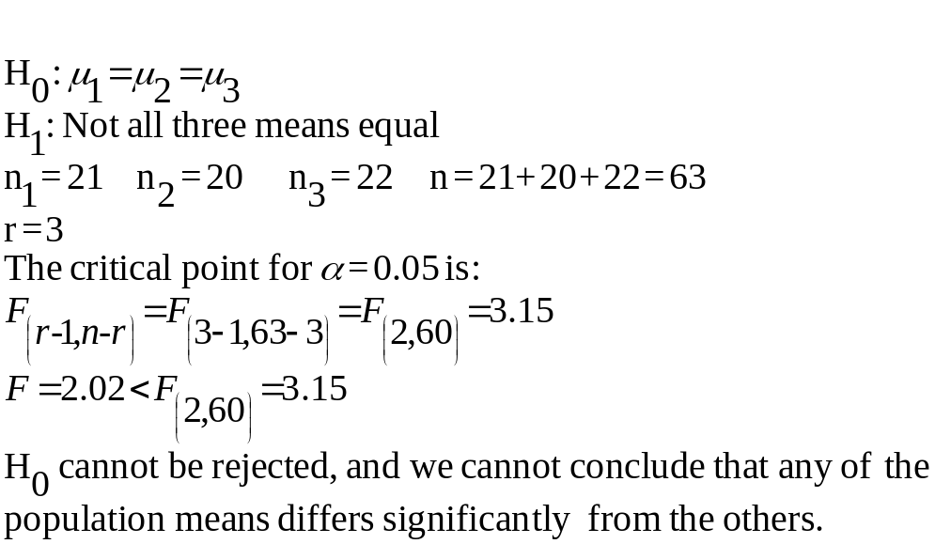
Example 9-1
_{9-<number>}
Randomly chosen groups of customers were served different types of coffee and asked to rate the coffee on a scale of 0 to 100: 21 were served pure Brazilian coffee, 20 were served pure Colombian coffee, and 22 were served pure African-grown coffee.
The resulting test statistic was F = 2.02
F Distribution with 2 and 60 Degrees of Freedom
0
.
7
0
.
6
0
.
)
5
0
.
F
4
(
f
0
.
3
0
.
2
α=0.05
0
.
1
0
.
0
0
1
2
3
4
5
F
Test Statistic=2.02
F_{(2,60)}=3.15

Slide 12
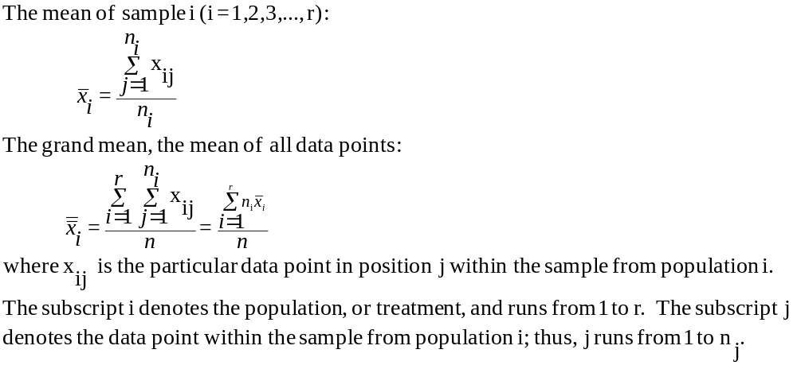
9-3 The Theory and the Computations of ANOVA: The Grand Mean
_{9-<number>}
The grand mean, x, is the mean of all n = n₁+ n₂+ n₃+...+ n_{r} observations
in all r samples.

Slide 13
Using the Grand Mean: Table 9-1
_{9-<number>}
Treatment (j)
Sample point(j)
Value(x
ij
)
I = 1 Triangle
1
4
Triangle
2
5
Triangle
3
7
x₁=6
Triangle
4
8
x₂=11.5
Mean of Triangles
6
I = 2 Square
1
10
x₃=2
x=6.909
Square
2
11
0
5
1
0
Square
3
12
Distance from data point to its sample mean
Square
4
13
Distance from sample mean to grand mean
Mean of Squares
11.5
I = 3 Circle
1
1
If the r population means are different (that is, at least two of the population means are not equal), then it is likely that the variation of the data points about their respective sample means (within sample variation) will be small relative to the variation of the r sample means about the grand mean (between sample variation).
Circle
2
2
Circle
3
3
Mean of Circ
les
2
Grand mean of all data points
6.909

Slide 14
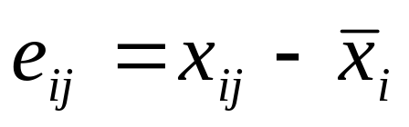
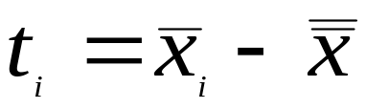
The Theory and Computations of ANOVA: Error Deviation and Treatment Deviation
_{9-<number>}
We define
an
error devi
ation
as the di
fference b
etween a d
ata point
and its sa
mple mean.
Errors a
re denoted
by
e
,
and we ha
ve:
We define
a
treatment
deviation
as the de
viation of
a sample
mean
from the g
rand mean.
Treatmen
t deviatio
ns,
t
,
are given
by:
i
The ANOVA principle says:
When the population means are not equal, the “average” error
(within sample) is relatively small compared with the “average”
treatment (between sample) deviation.

Slide 15
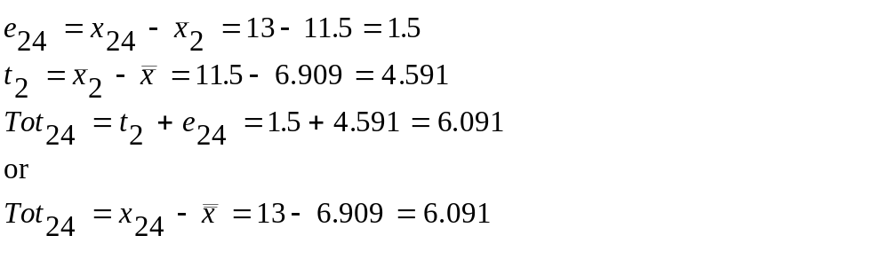
The Theory and Computations of ANOVA: The Total Deviation
_{9-<number>}
The total deviation (Tot_{ij}) is the difference between a data point (x_{ij}) and the grand mean (x): Tot_{ij}=x_{ij} - x
For any data point x_{ij}:
Tot = t + e
That is:
Total Deviation = Treatment Deviation + Error Deviation
Consider data point x₂₄=13 from table 9-1. The mean of sample 2 is 11.5, and the grand mean is 6.909, so:
Total deviation:
Tot₂₄=x₂₄-x=6.091
Error deviation:
e₂₄=x₂₄-x₂=1.5
x₂₄=13
Treatment deviation:
t₂=x₂-x=4.591
x₂=11.5
x = 6.909
0
5
1
0

Slide 16
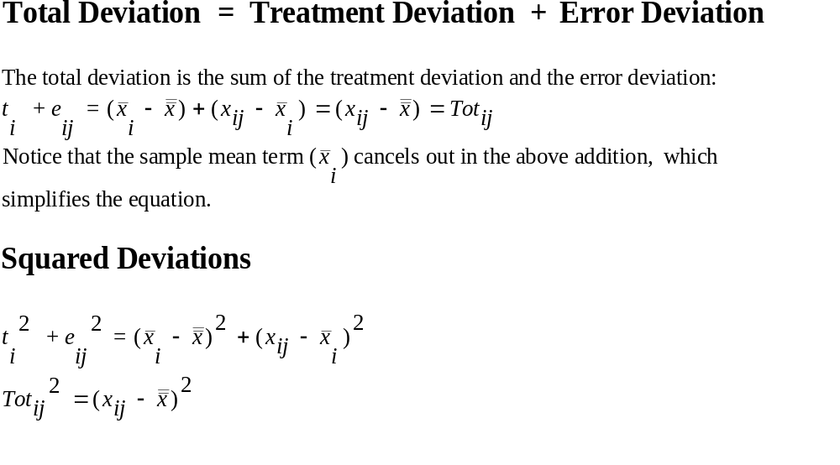
The Theory and Computations of ANOVA: Squared Deviations
_{9-<number>}

Slide 17
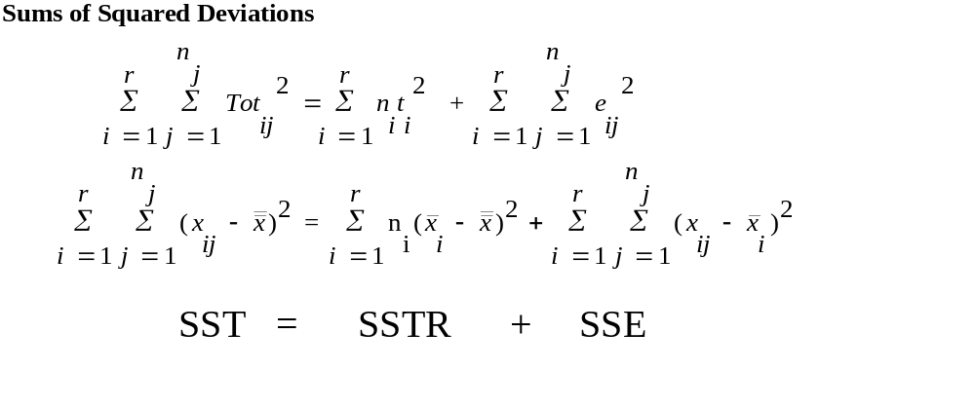
The Theory and Computations of ANOVA: The Sum of Squares Principle
_{9-<number>}
The Sum of Squares Principle
The total sum of squares (SST) is the sum of two terms: the sum of squares for treatment (SSTR) and the sum of squares for error (SSE).
SST = SSTR + SSE

Slide 18
The Theory and Computations of ANOVA: Picturing The Sum of Squares Principle
_{9-<number>}
SSTR
SSE
SST
SST measures the total variation in the data set, the variation of all individual data points from the grand mean.
SSTR measures the explained variation, the variation of individual sample means from the grand mean. It is that part of the variation that is possibly expected, or explained, because the data points are drawn from different populations. It’s the variation between groups of data points.
SSE measures unexplained variation, the variation within each group that cannot be explained by possible differences between the groups.

Slide 19
The Theory and Computations of ANOVA: Degrees of Freedom
_{9-<number>}
The number of degrees of freedom associated with SST is (n - 1).
n total observations in all r groups, less one degree of freedom lost with the calculation of the grand mean
The number of degrees of freedom associated with SSTR is (r - 1).
r sample means, less one degree of freedom lost with the
calculation of the grand mean
The number of degrees of freedom associated with SSE is (n-r).
n total observations in all groups, less one degree of freedom
lost with the calculation of the sample mean from each of r groups
The degrees of freedom are additive in the same way as are the sums of squares:
df(total) = df(treatment) + df(error)
(n - 1) = (r - 1) + (n - r)

Slide 20
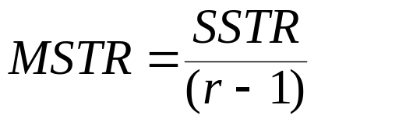
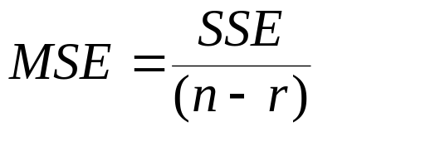
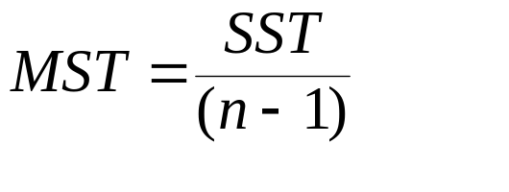
The Theory and Computations of ANOVA: The Mean Squares
_{9-<number>}
Recall that the calculation of the sample variance involves the division of the sum of squared deviations from the sample mean by the number of degrees of freedom. This principle is applied as well to find the mean squared deviations within the analysis of variance.
Mean square treatment (MSTR):
Mean square error (MSE):
Mean square total (MST):
(Note that the additive properties of sums of squares do not extend to the mean squares. MST ≠ MSTR + MSE.

Slide 21
The Theory and Computations of ANOVA: The Expected Mean Squares
_{9-<number>}
E
(
MSE
)
=
σ
2
and
∑
n
(
μ
−
μ
)
2
2
2
i
i
=
σ
when the
null hypot
hesis is t
rue
E
(
MSTR
)
=
σ
+
r
−
1
>
σ
2
when the
null hypot
hesis is f
alse
where
μ
i
is the me
an of popu
lation i a
nd
μ
is the c
ombined me
an of all
r populati
ons.
That is, the expected mean square error (MSE) is simply the common population variance (remember the assumption of equal population variances), but the expected treatment sum of squares (MSTR) is the common population variance plus a term related to the variation of the individual population means around the grand population mean.
If the null hypothesis is true so that the population means are all equal, the second term in the E(MSTR) formulation is zero, and E(MSTR) is equal to the common population variance.

Slide 22
Expected Mean Squares and the
ANOVA Principle
_{9-<number>}
When the null hypothesis of ANOVA is true and all r population means are equal, MSTR and MSE are two independent, unbiased estimators of the common population variance σ².
On the other hand, when the null hypothesis is false, then MSTR will tend to be larger than MSE.
So the ratio of MSTR and MSE can be used as an indicator of the equality or inequality of the r population means.
This ratio (MSTR/MSE) will tend to be near to 1 if the null hypothesis is true, and greater than 1 if the null hypothesis is false. The ANOVA test, finally, is a test of whether (MSTR/MSE) is equal to, or greater than, 1.

Slide 23
The Theory and Computations of ANOVA: The F Statistic
_{9-<number>}
Under the assumptions of ANOVA, the ratio (MSTR/MSE) possess an F distribution with (r-1) degrees of freedom for the numerator and (n-r) degrees of freedom for the denominator when the null hypothesis is true.
The test s
tatistic i
n analysis
of varian
ce:
MSTR
F
=
(
r
-
1
,
n
-
r
)
MSE

Slide 24
9-4 The ANOVA Table and Examples
_{9-<number>}
Treatment (i)
i
j
Value (x
ij
)
(x
ij
-x
i
)
(x
ij
-x
i
)
2
n
r
j
2
Triangle
1
1
4
-2
4
SSE
=
∑
∑
(
x
−
x
)
=
17
Triangle
1
2
5
-1
1
i
=
1
j
=
1
ij
i
Triangle
1
3
7
1
1
Triangle
1
4
8
2
4
r
2
Square
2
1
10
-1.5
2.25
SSTR
=
∑
n
(
x
−
x
)
=
159
.
9
Square
2
2
11
-0.5
0.25
i
=
1
i
i
Square
2
3
12
0.5
0.25
SSTR
159
.
9
Square
2
4
13
1.5
2.25
MSTR
=
=
=
79
.
95
Circle
3
1
1
-1
1
r
−
1
(
3
−
1
)
Circle
3
2
2
0
0
SSTR
17
Circle
3
3
3
1
1
MSE
=
=
=
2
.
125
73
0
17
n
−
r
8
Treatment
(x
-x)
(x
-x)
2
n
(x
-x)
2
=
MSTR
=
79
.
95
=
i
i
i
i
F
37
.
62
.
Triangle
-0.909
0.826281
3.305124
(
2
,
8
)
MSE
2
.
125
Square
4.591
21.077281
84.309124
Critical p
oint (
α
=
0.01):
8.65
Circle
-4.909
124.098281
72.294843
H
may be rej
ected at t
he 0.01 le
vel
159.909091
0
of signifi
cance.

Slide 25
ANOVA Table
_{9-<number>}
Source of
Sum of
Degrees of
Variation
Squares
Freedom
Mean Square
F Ratio
Treatment
SSTR=159.9
(r-1)=2
MSTR=79.95
37.62
Error
SSE=17.0
(n-r)=8
MSE=2.125
Total
SST=176.9
(n-1)=10
MST=17.69
F
D
i
s
t
r
i
b
u
t
i
o
n
f
o
r
2
a
n
d
8
D
e
g
r
e
e
s
o
f
F
r
e
e
d
o
m
The ANOVA Table summarizes the ANOVA calculations.
In this instance, since the test statistic is greater than the critical point for an α = 0.01 level of significance, the null hypothesis may be rejected, and we may conclude that the means for triangles, squares, and circles are not all equal.
0
.
7
0
.
6
0
.
5
Computed test statistic=37.62
0
.
4
f(F)
0
.
3
0
.
2
0
0.01
.
1
0
.
0
F_{(2,8)}
0
10
8.65

Slide 26
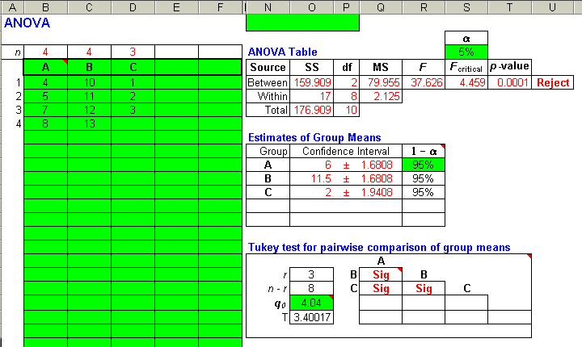
Template Output
_{9-<number>}
Decision:
Reject the
Null Hypothesis

Slide 27
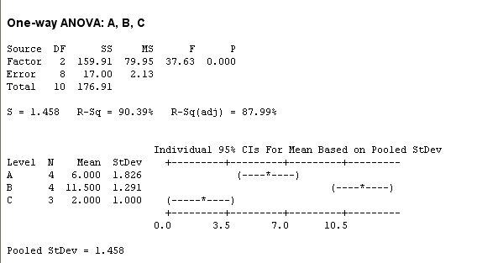
Minitab Output
_{9-<number>}
Decision:
Reject the
Null Hypothesis

Slide 28
Example 9-2: Club Med
_{9-<number>}
Club Med has conducted a test to determine whether its Caribbean resorts are equally well liked by vacationing club members. The analysis was based on a survey questionnaire (general satisfaction, on a scale from 0 to 100) filled out by a random sample of 40 respondents from each of 5 resorts.
Resort
Mean Response (x )
Source of
Sum of
Degrees of
i
Variation
Squares
Freedom
Mean Square
F Ratio
Guadeloupe
89
Martinique
75
Treatment
SSTR=
14208
(r-1)=
4
MSTR=
3552
7.04
Eleuthra
73
Error
SSE=98356
(n-r)=
195
MSE=
504.39
Paradise Island
91
Total
SST=112564
(n-1)=
199
MST=
565.65
St. Lucia
85
F Distribution with 4 and 200 Degrees of Freedom
SST=112564
SSE=98356
0
.
7
The resultant F ratio is larger than the critical point for α = 0.01, so the null hypothesis may be rejected.
0
.
6
0
.
5
Computed test statistic=7.04
0
.
4
f(F)
0
.
3
0
.
2
0
0.01
.
1
0
.
0
F_{(4,200)}
0
3.41

Slide 29
Example 9-3: Job Involvement
_{9-<number>}
Source of
Sum of
Degrees of
Variation
Squares
Freedom
Mean Square
F Ratio
Treatment
SSTR=
879.3
(r-1)=3
MSTR=
293.1
8.52
Error
SSE=
18541.6
(n-r)=
539
MSE=34.4
Total
SST=
19420.9
(n-1)=542
MST=
35.83
Given the total number of observations (n = 543), the number of groups (r = 4), the MSE (34. 4), and the F ratio (8.52), the remainder of the ANOVA table can be completed. The critical point of the F distribution for α = 0.01 and (3, 400) degrees of freedom is 3.83. The test statistic in this example is much larger than this critical point, so the p value associated with this test statistic is less than 0.01, and the null hypothesis may be rejected.

Slide 30
9-5 Further Analysis
_{9-<number>}
ANOVA
Do Not Reject H₀
Stop
Data
Reject H₀
The sample means are unbiased estimators of the population means.
The mean square error (MSE) is an unbiased estimator of the common population variance.
Confidence Intervals for Population Means
Further Analysis
Tukey Pairwise Comparisons Test
The ANOVA Diagram

Slide 31
Confidence Intervals for Population Means
_{9-<number>}
A (1
-
α
) 100% confidence interval for
μ
,
the mean of population i:
i
±
MSE
x
t
i
α
n
2
i
where t
is the value of the
t
distribution with
(n
-
r
) degrees
of
α
α
2
freedom that cuts off a right - tailed area of
.
2
Resort
Mean Response (x
i
)
MSE
504
.
39
Guadeloupe
89
x
±
t
=
x
±
1
.
96
=
x
±
6
.
96
i
α
n
i
40
i
Martinique
75
2
i
89
±
6
.
96
=
[
82
.
04
,
95
.
96]
Eleuthra
73
±
=
Paradise Island
91
75
6
.
96
[
68
.
04
,
81
.
96]
73
±
6
.
96
=
[
66
.
04
,
79
.
96]
St. Lucia
85
±
=
91
6
.
96
[
84
.
04
,
97
.
96]
SST = 112564
SSE = 98356
85
±
6
.
96
=
[
78
.
04
,
91
.
96]
n
= 40
n = (5)(40) = 200
i
MSE = 504.39

Slide 32
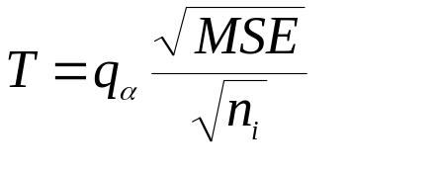
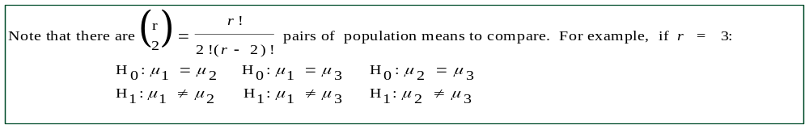
The Tukey Pairwise-Comparisons Test
_{9-<number>}
The Tukey Pairwise Comparison test, or Honestly Significant Differences (MSD) test, allows us to compare every pair of population means with a single level of significance.
It is based on the studentized range distribution, q, with r and (n-r) degrees of freedom.
The critical point in a Tukey Pairwise Comparisons test is the Tukey Criterion:
where n_{i} is the smallest of the r sample sizes.
The test statistic is the absolute value of the difference between the appropriate sample means, and the null hypothesis is rejected if the test statistic is greater than the critical point of the Tukey Criterion

Slide 33
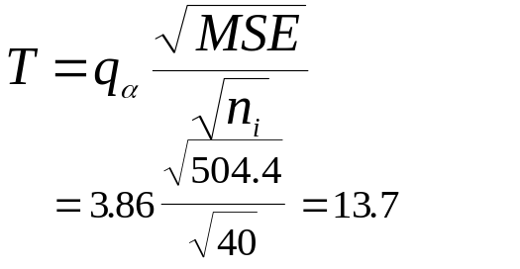
The Tukey Pairwise Comparison Test: The Club Med Example
_{9-<number>}
The test statistic for each pairwise test is the absolute difference between the appropriate sample means.
i Resort Mean I. H₀: μ₁ = μ₂ VI. H₀: μ₂ = μ₄
1 Guadeloupe 89 H₁: μ₁ ≠ μ₂ H₁: μ₂ ≠ μ₄
2 Martinique 75 |89-75|=14>13.7* |75-91|=16>13.7*
3 Eleuthra 73 II. H₀: μ₁ = μ₃ VII. H₀: μ₂ = μ₅
4 Paradise Is. 91 H₁: μ₁ ≠ μ₃ H₁: μ₂ ≠ μ₅
5 St. Lucia 85 |89-73|=16>13.7* |75-85|=10<13.7
III. H₀: μ₁ = μ₄ VIII. H₀: μ₃ = μ₄
The critical point T_{0.05} for H₁: μ₁ ≠ μ₄ H₁: μ₃ ≠ μ₄
r=5 and (n-r)=195 |89-91|=2<13.7 |73-91|=18>13.7*
degrees of freedom is: IV. H₀: μ₁ = μ₅ IX. H₀: μ₃ = μ₅
H₁: μ₁ ≠ μ₅ H₁: μ₃ ≠ μ₅
|89-85|=4<13.7 |73-85|=12<13.7
V. H₀: μ₂ = μ₃ X. H₀: μ₄ = μ₅
H₁: μ₂ ≠ μ₃ H₁: μ₄ ≠ μ₅
|75-73|=2<13.7 |91-85|= 6<13.7
Reject the null hypothesis if the absolute value of the difference between the sample means is greater than the critical value of T. (The hypotheses marked with * are rejected.)

Slide 34
Picturing the Results of a Tukey Pairwise Comparisons Test: The Club Med Example
_{9-<number>}
We rejected the null hypothesis which compared the means of populations 1 and 2, 1 and 3, 2 and 4, and 3 and 4. On the other hand, we accepted the null hypotheses of the equality of the means of populations 1 and 4, 1 and 5, 2 and 3, 2 and 5, 3 and 5, and 4 and 5.
The bars indicate the three groupings of populations with possibly equal means: 2 and 3; 2, 3, and 5; and 1, 4, and 5.
μ₃
μ₂
μ₅
μ₁
μ₄

Slide 35
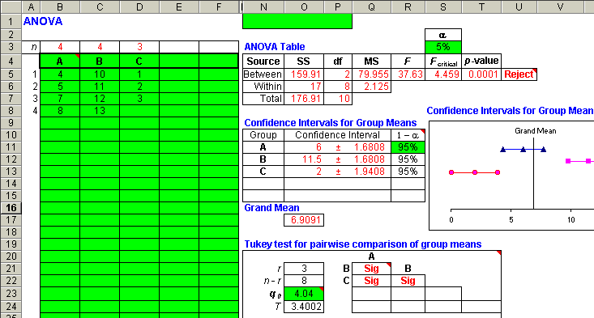
Picturing the Results of a Tukey Pairwise Comparisons Test: The Club Med Example
_{9-<number>}

Slide 36
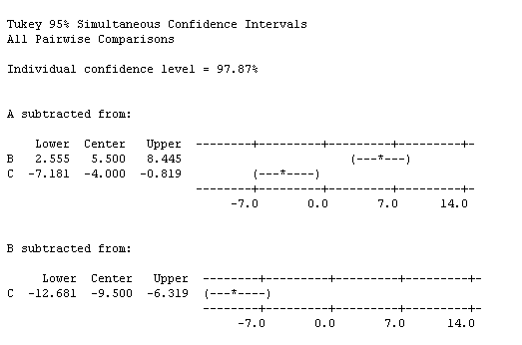
Picturing the Results of a Tukey Pairwise Comparisons Test: The Club Med Example
_{9-<number>}
NOTE: Zero is not
included in the intervals.
Thus there is a
significant difference
between the means
for A and B, A and C,
and B and C.

Slide 37
9-6 Models, Factors and Designs
_{9-<number>}
A statistical model is a set of equations and assumptions that capture the essential characteristics of a real-world situation
  The one-factor ANOVA model:
    x_{ij}=μ_{i}+ε_{ij}=μ+α_{i}+ε_{ij}
    where ε_{ij} is the error associated with the jth member of the ith population. The errors are assumed to be normally distributed with mean 0 and variance σ².

Slide 38
9-6 Models, Factors and Designs (Continued)
_{9-<number>}
A factor is a set of populations or treatments of a single kind. For example:
  One factor models based on sets of resorts, types of airplanes, or kinds of sweaters
  Two factor models based on firm and location
  Three factor models based on color and shape and size of an ad.
Fixed-Effects and Random Effects
  A fixed-effects model is one in which the levels of the factor under study (the treatments) are fixed in advance. Inference is valid only for the levels under study.
  A random-effects model is one in which the levels of the factor under study are randomly chosen from an entire population of levels (treatments). Inference is valid for the entire population of levels.

Slide 39
Experimental Design
_{9-<number>}
A completely-randomized design is one in which the elements are assigned to treatments completely at random. That is, any element chosen for the study has an equal chance of being assigned to any treatment.
In a blocking design, elements are assigned to treatments after first being collected into homogeneous groups.
  In a completely randomized block design, all members of each block (homogeneous group) are randomly assigned to the treatment levels.
  In a repeated measures design, each member of each block is assigned to all treatment levels.

Slide 40
9-7 Two-Way Analysis of Variance
_{9-<number>}
In a two-way ANOVA, the effects of two factors or treatments can be investigated simultaneously. Two-way ANOVA also permits the investigation of the effects of either factor alone and of the two factors together.
  The effect on the population mean that can be attributed to the levels of either factor alone is called a main effect.
  An interaction effect between two factors occurs if the total effect at some pair of levels of the two factors or treatments differs significantly from the simple addition of the two main effects. Factors that do not interact are called additive.
Three questions answerable by two-way ANOVA:
  Are there any factor A main effects?
  Are there any factor B main effects?
  Are there any interaction effects between factors A and B?
For example, we might investigate the effects on vacationers’ ratings of resorts by looking at five different resorts (factor A) and four different resort attributes (factor B). In addition to the five main factor A treatment levels and the four main factor B treatment levels, there are (5*4=20) interaction treatment levels.3

Slide 41
The Two-Way ANOVA Model
_{9-<number>}
x_{ijk}=μ+α_{i}+ β_{j} + (αβ)_{ij} + ε_{ijk}
  where μ is the overall mean;
  α_{i} is the effect of level i(i=1,...,a) of factor A;
  β_{j} is the effect of level j(j=1,...,b) of factor B;
  (αβ)_{jj} is the interaction effect of levels i and j;
  ε_{jjk} is the error associated with the kth data point from level i of factor A and level j of factor B.
  ε_{jjk} is assumed to be distributed normally with mean zero and variance σ² for all i, j, and k.

Slide 42
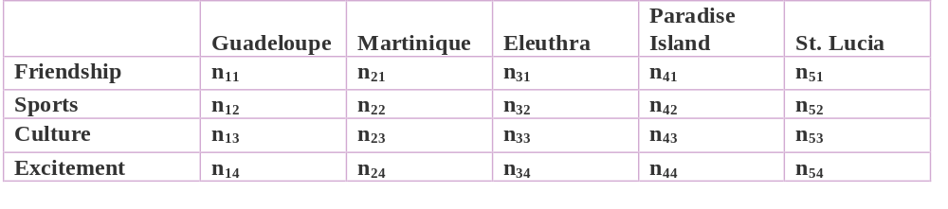
Two-Way ANOVA Data Layout:
Club Med Example
_{9-<number>}
Factor A: Resort
Factor B:
Attribute
G
Eleuthra/sports interaction: Combined effect greater than additive main effects
r
a
p
h
i
c
a
l
D
i
s
p
l
a
y
o
f
E
f
f
e
c
t
s
Rating
Friendship
Friendship
Excitement
Attribute
Sports
Excitement
Culture
g
Sports
n
i
t
a
R
Culture
Eleuthra
St. Lucia
Paradise island
Resort
Martinique
Guadeloupe
St. Lucia
Paradise Island
Eleuthra
R
Martinique
Guadeloupe
e
s
o
r
t

Slide 43
Hypothesis Tests a Two-Way ANOVA
_{9-<number>}
Factor A main effects test:
  H₀: α_{i}= 0 for all i=1,2,...,a
  H₁: Not all α_{i} are 0
Factor B main effects test:
  H₀: β_{j}= 0 for all j=1,2,...,b
  H₁: Not all β_{i} are 0
Test for (AB) interactions:
  H₀: (αβ)_{ij}= 0 for all i=1,2,...,a and j=1,2,...,b
  H₁: Not all (αβ)_{ij} are 0

Slide 44
Sums of Squares
_{9-<number>}
In a two-way ANOVA:
  x_{ijk}=μ+α_{i}+ β_{j} + (αβ)_{ijk} + ε_{ijk}
    SST = SSTR +SSE
    SST = SSA + SSB +SS(AB)+SSE
SST
=
SSTR
+
SSE
∑
∑
∑
(
x
−
x
)
2
=
∑
∑
∑
(
x
−
x
)
2
+
∑
∑
∑
(
x
−
x
)
2
SSTR
=
SSA
+
SSB
+
SS
(
AB
)
=
∑
∑
∑
(
x
−
x
)
2
+
∑
∑
∑
(
x
−
x
)
2
+
∑
∑
∑
(
x
+
x
+
x
−
x
)
2
i
j
ij
i
j

Slide 45
The Two-Way ANOVA Table
_{9-<number>}
Source of
Sum of
Degrees
Variation
Squares
of Freedom
Mean Square
F Ratio
Factor A
SSA
a-1
=
SSA
=
MSA
MSA
−
F
a
1
MSE
Factor B
SSB
b-1
=
SSB
F
=
MSB
MSB
−
MSE
b
1
Interaction
SS(AB)
(a-1)(b-1)
=
SS
(
AB
)
F
=
MS
(
AB
)
MS
(
AB
)
−
−
MSE
(
a
1
)(
b
1
)
Error
SSE
ab(n-1)
=
SSE
MSE
−
ab
(
n
1
)
Total
SST
abn-1
A Main Effect Test: F_{(a-1,ab(n-1))} B Main Effect Test: F_{(b-1,ab(n-1))}
(AB) Interaction Effect Test: F_{((a-1)(b-1),ab(n-1))}

Slide 46
Example 9-4: Two-Way ANOVA (Location and Artist)
_{9-<number>}
Source of
Sum of
Degrees
Variation
Squares
of Freedom
Mean Square
F Ratio
Location
1824
2
912
8.94
Artist
2230
2
1115
10.93
Interaction
804
4
201
1.97
Error
8262
81
102
Total
13120
89
α =0.01, F_{(2,81)}=4.88 ⇒ Both main effect null hypotheses are rejected.
α=0.05, F_{(2,81)}=2.48 ⇒ Interaction effect null hypotheses are not rejected.

Slide 47
Hypothesis Tests
_{9-<number>}
F
D
i
s
t
r
i
b
u
t
i
o
n
w
i
t
h
2
a
n
d
8
1
D
e
g
r
e
e
s
o
f
F
r
e
e
d
o
m
F
D
i
s
t
r
i
b
u
t
i
o
n
w
i
t
h
4
a
n
d
8
1
D
e
g
r
e
e
s
o
f
F
r
e
e
d
o
m
0
.
0
7
.
7
Location test statistic=8.94
Artist test statistic=10.93
0
.
0
6
.
6
Interaction test statistic=1.97
0
.
0
5
.
5
)
0
.
)
0
4
.
F
4
F
(
(
f
f
0
.
0
3
.
3
α=0.01
α=0.05
0
.
0
2
.
2
0
.
0
1
.
1
0
F
.
0
0
.
0
F
0
1
2
3
4
5
6
0
1
2
3
4
5
6
F_{0.01}=4.88
F_{0.05}=2.48

Slide 48
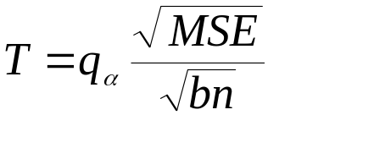
Overall Significance Level and Tukey Method for Two-Way ANOVA
_{9-<number>}
Kimball’s Inequality gives an upper limit on the true probability of at least one Type I error in the three tests of a two-way analysis:
α ≤ 1- (1-α₁) (1-α₂) (1-α₃)
Tukey Criterion for factor A:
where the degrees of freedom of the q distribution are now a and ab(n-1). Note that MSE is divided by bn.

Slide 49
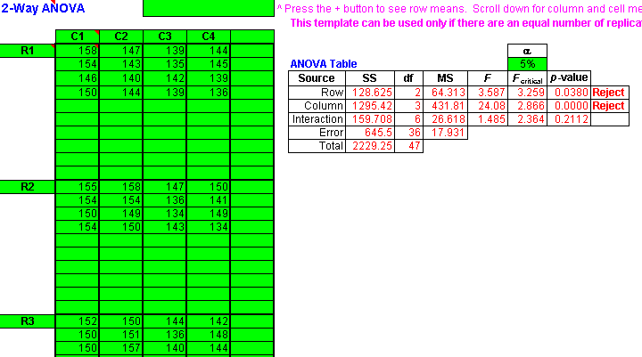
Template for a Two-Way ANOVA
_{9-<number>}

Slide 50
Extension of ANOVA to Three Factors
_{9-<number>}
Source of
Sum of
Degrees
Variation
Squares
of Freedom
Mean Square
F Ratio
Factor A
SSA
a-1
MSA
=
SSA
F
=
MSA
a
−
1
MSE
Factor B
SSB
b-1
MSB
=
SSB
F
=
MSB
b
−
1
MSE
Factor C
SSC
c-1
MSC
=
SSC
F
=
MSC
c
−
1
MSE
Interaction
SS(AB)
(a-1)(b-1)
MS
(
AB
)
=
SS
(
AB
)
F
=
MS
(
AB
)
(AB)
(
a
−
1
)(
b
−
1
)
MSE
Interaction
SS(AC)
(a-1)(c-1)
MS
(
AC
)
=
SS
(
AC
)
F
=
MS
(
AC
)
(AC)
(
a
−
1
)(
c
−
1
)
MSE
Interaction
SS(BC)
(b-1)(c-1)
MS
(
BC
)
=
SS
(
BC
)
F
=
MS
(
BC
)
(BC)
(
b
−
1
)(
c
−
1
)
MSE
Interaction
SS(ABC)
(a-1)(b-1)(c-1)
MS
(
ABC
)
=
SS
(
ABC
)
F
=
MS
(
ABC
)
(ABC)
(
a
−
1
)(
b
−
1
)(
c
−
1
)
MSE
Error
SSE
abc(n-1)
MSE
=
SSE
abc
(
n
−
1
)
Total
SST
abcn-1

Slide 51
Two-Way ANOVA with One Observation per Cell
_{9-<number>}
The case of one data point in every cell presents a problem in two-way ANOVA.
There will be no degrees of freedom for the error term.
What can be done?
If we can assume that there are no interactions between the main effects, then we can use SS(AB) and its associated degrees of freedom (a – 1)(b – 1) in place of SSE and its degrees of freedom.
We can then conduct main effects tests using MS(AB).
See the next slide for the ANOVA table.

Slide 52





Two-Way ANOVA with One Observation per Cell
_{9-<number>}
Source of Variation | Sum of Squares | Degrees of Freedom | Mean Square | F Ratio
Factor A | SSA | a - 1
Factor B | SSB | b - 1
“Error” | SS(AB) | (a – 1)(b – 1)
Total | SST | ab - 1

Slide 53
9-8 Blocking Designs
_{9-<number>}
A block is a homogeneous set of subjects, grouped to minimize within-group differences.
A competely-randomized design is one in which the elements are assigned to treatments completely at random. That is, any element chosen for the study has an equal chance of being assigned to any treatment.
In a blocking design, elements are assigned to treatments after first being collected into homogeneous groups.
  In a completely randomized block design, all members of each block (homogenous group) are randomly assigned to the treatment levels.
  In a repeated measures design, each member of each block is assigned to all treatment levels.

Slide 54
Model for Randomized Complete Block Design
_{9-<number>}
x_{ij}=μ+α_{i}+ β_{j} + ε_{ij}
  where μ is the overall mean;
  α_{i} is the effect of level i(i=1,...,a) of factor A;
  β_{j} is the effect of block j(j=1,...,b);
  ε_{ij} is the error associated with x_{ij}
  ε_{ij} is assumed to be distributed normally with mean zero and variance σ² for all i and j.

Slide 55
ANOVA Table for Blocking Designs: Example 9-5
_{9-<number>}
Source of Variation
Sum of Squares
Degress of Freedom
Mean Square
F Ratio
Blocks
SSBL
n - 1
MSBL = SSBL/(n-1)
F = MSBL/MSE
Treatments
SSTR
r - 1
MSTR = SSTR/(r-1)
F = MSTR/MSE
Error
SSE
(n -1)(r - 1)
MSE = SSE/(n-1)(r-1)
Total
SST
nr - 1
Source of Variation
Sum of Squares
df
Mean Square
F Ratio
Blocks
2750
39
70.51
0.69
Treatments
2640
2
1320
12.93
Error
7960
78
102.05
Total
13350
119
α = 0.01, F(2, 78) = 4.88

Slide 56
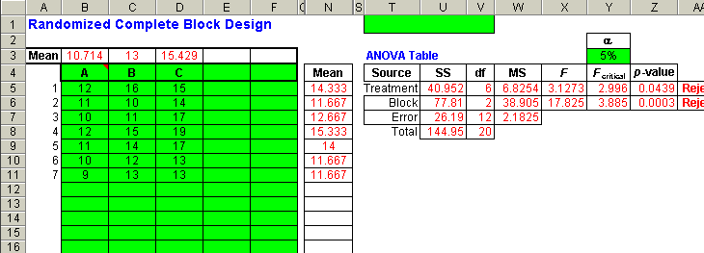
Template for the Randomized Complete Block Design
_{9-<number>}

Slide 57
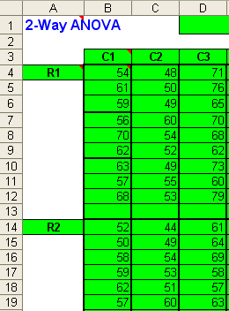
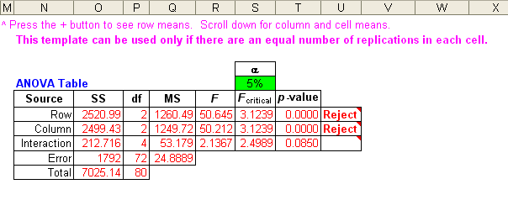
Two-Way ANOVA Using the Template for Problem 9-42
_{9-<number>}

Slide 58
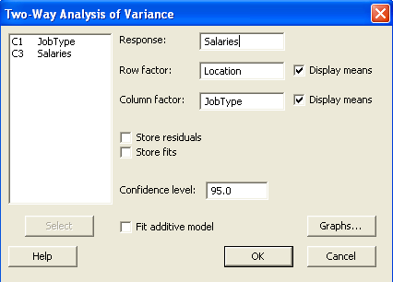
Two-Way ANOVA Using Minitab for Problem 9-42
_{9-<number>}

Slide 59
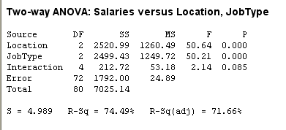
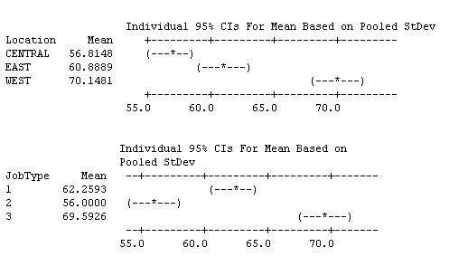
Two-Way ANOVA Using Minitab for Problem 9-42
_{9-<number>}

